Slide 1

Orion Blackstock (618684)
Course Project — Software Engineering
GitHub: github.com/StockDev136/SWE_Final_Project_HPCRMS

Slide 2

OUR VISION
“
Transform traditional vehicle rental operations into a seamless digital experience — minimizing customer wait times, automating rental processes, and providing fast, secure, and convenient access to vehicles.
The system will improve operational efficiency, maximize fleet utilization, and deliver a superior customer experience across all rental locations.
⏱
⚙
⚡
📈
Minimize Wait Times
Automate Rental Processes
Fast, Secure Access
Maximize Fleet Utilization

Slide 3
What We'll Cover
01
The Problem
Why traditional car rental counters fall short
05
System Architecture
The technical foundation — React + Spring Boot
02
Our Solution
What HPCRMS delivers, end to end
06
Sequence Diagrams
Reservation, Check-In, and Payment traced step by step
03
Key Features
The capabilities that define the platform
07
Collaboration & VOPC
Object collaborations and participating classes
04
Use-Case Model
How customers and staff interact with the system
08
Roadmap
From documentation to a working system
03

Slide 4
THE PROBLEM
Renting a car still feels stuck in the past
1
2
3
4
Long counter wait times
No real-time visibility
Paper-heavy processes
Fragmented fleet oversight
Manual paperwork and in-person ID checks slow every pickup, even for returning customers.
Vehicle availability isn't synchronized across branches, leading to overbooking and lost reservations.
Rental agreements, inspections, and payments are still handled on paper or disconnected tools.
Maintenance schedules and utilization data live in spreadsheets, not a single source of truth.
04

Slide 5
OUR SOLUTION
HPCRMS: one platform for the entire rental lifecycle
The High Priority Car Rental Management System digitizes reservation, identity verification, digital check-in, payment, pickup, return, and fleet operations — replacing manual counter processes with a fast, self-service experience backed by a real-time, centralized platform.
Register & Verify
1
Search & Reserve
2
Digital Check-In
3
≤ 2 sec
≤ 5 sec
Pay Securely
4
vehicle search response
reservation confirmation
QR Pickup
1,000+
99.9%
5
Return & Inspect
concurrent users supported
platform availability target
6
05

Slide 6
KEY FEATURES
Everything a modern rental experience needs
Customer Accounts
Search & Reserve
Identity Verification
Digital Check-In
Secure Payment
Registration, login, and profile & rental history
Real-time cross-branch availability search
Automated driver's-license & selfie validation
Paperless rental agreement with e-signature
Card payments, receipts, and refunds
QR Code Pickup
Return & Inspection
Fleet Management
Reports & Analytics
Roles & Security
Skip the counter with a scannable pickup code
Digitized condition, mileage & damage capture
Inventory, vehicle assignment & maintenance
Utilization, revenue, and demand forecasting
RBAC, MFA, and end-to-end encryption
06

Slide 7
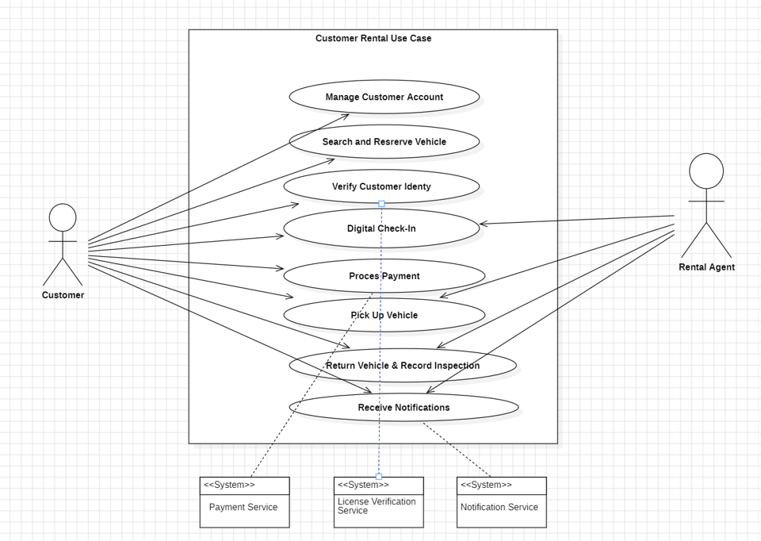
USE-CASE MODEL
The customer rental lifecycle
From registration through reservation, identity verification, digital check-in, payment, pickup, return, and notifications — modeled from the project's SRS.
07

Slide 8
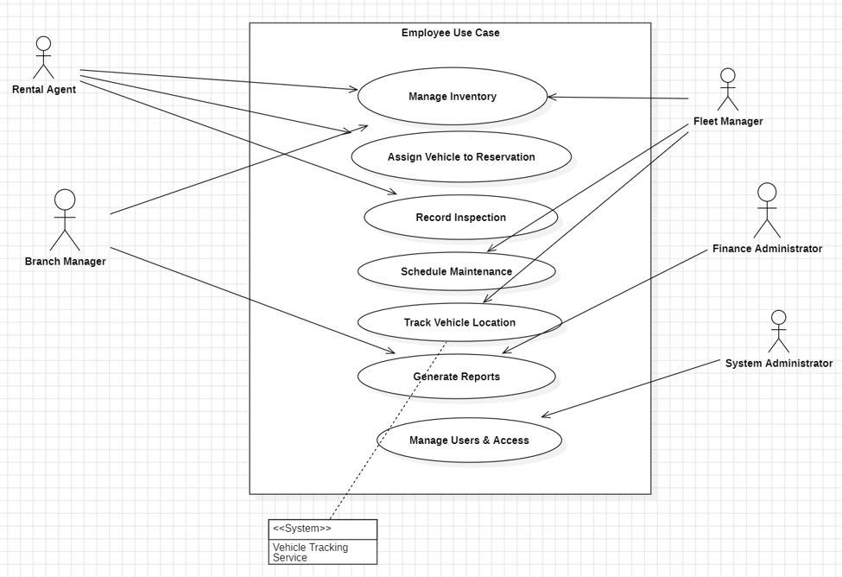
USE-CASE MODEL
Fleet, administration & reporting
Staff-facing use cases covering vehicle inventory, maintenance scheduling, reporting/analytics, and role-based user administration.
08

Slide 9
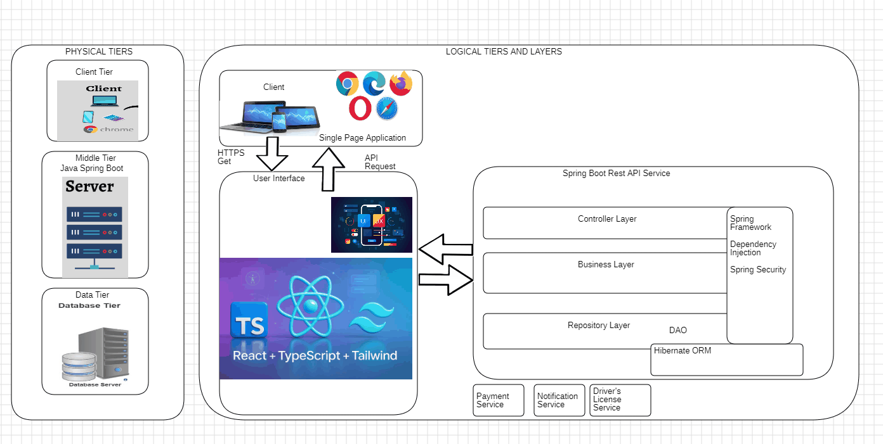
SYSTEM ARCHITECTURE
A layered client–server architecture
A React + TypeScript + Tailwind single-page application talks to a layered Spring Boot REST API (Controller / Business / Repository, with Spring Security and Hibernate ORM), backed by a centralized database and third-party services.
09

Slide 10
TECH STACK
Built on a modern, proven foundation
FRONTEND
BACKEND
SECURITY
React + TypeScript
Spring Boot
Spring Security
Single-page application, Tailwind CSS
Layered REST API — Controller / Service / Repository
Authentication, RBAC, dependency injection
DATA ACCESS
DATABASE
INTEGRATIONS
Hibernate ORM / DAO
HPCRMS Database
Payment, Notification, License Services
Repository layer over the database
Centralized relational store, real-time sync
Called from the Business layer only
10

Slide 11
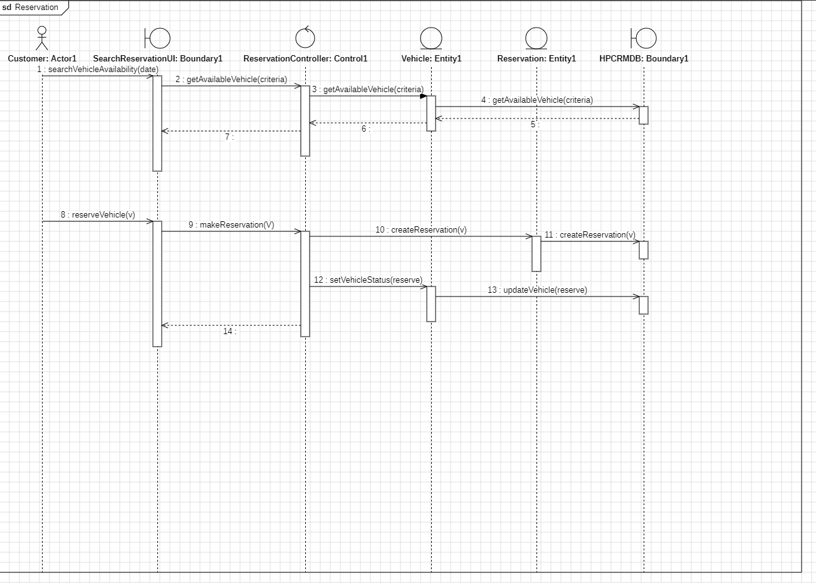
SEQUENCE DIAGRAMS
Tracing a use case: Reservation
Customer, boundary, control, entity, and database classes collaborate to search availability and create a reservation — the same Boundary/Control/Entity pattern used throughout the analysis.
11

Slide 12
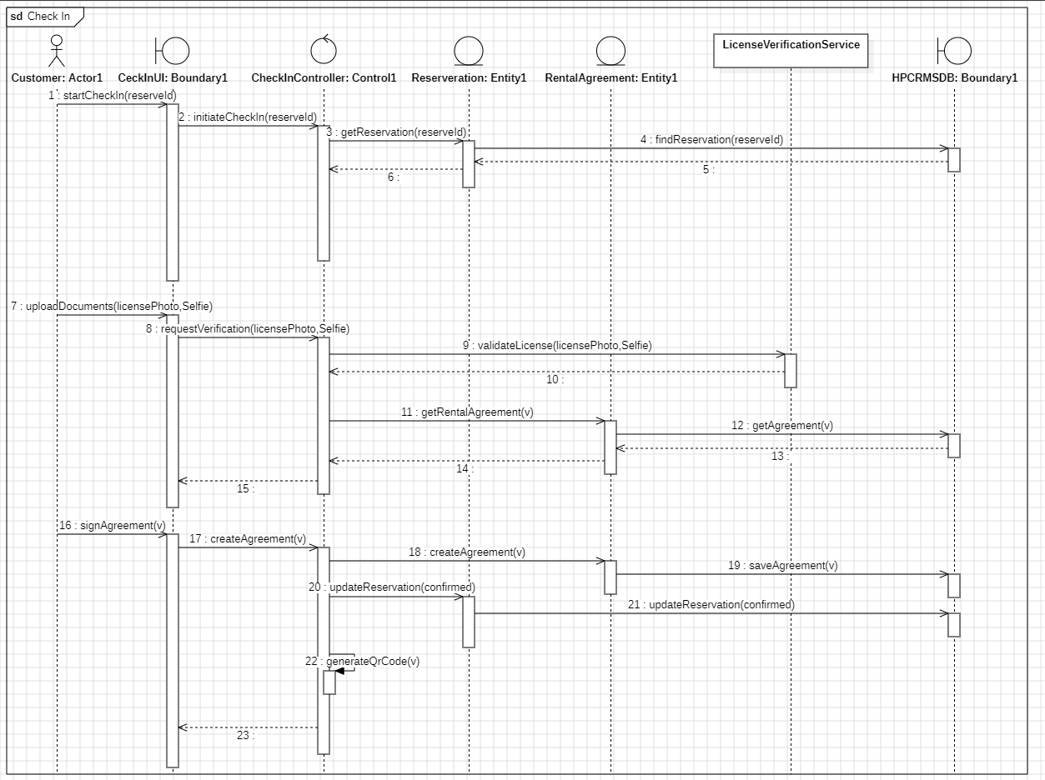
SEQUENCE DIAGRAMS
Tracing a use case: Check-In
Digital check-in coordinates identity verification through the external License Verification Service, generates the rental agreement, and persists the signed contract.
12

Slide 13
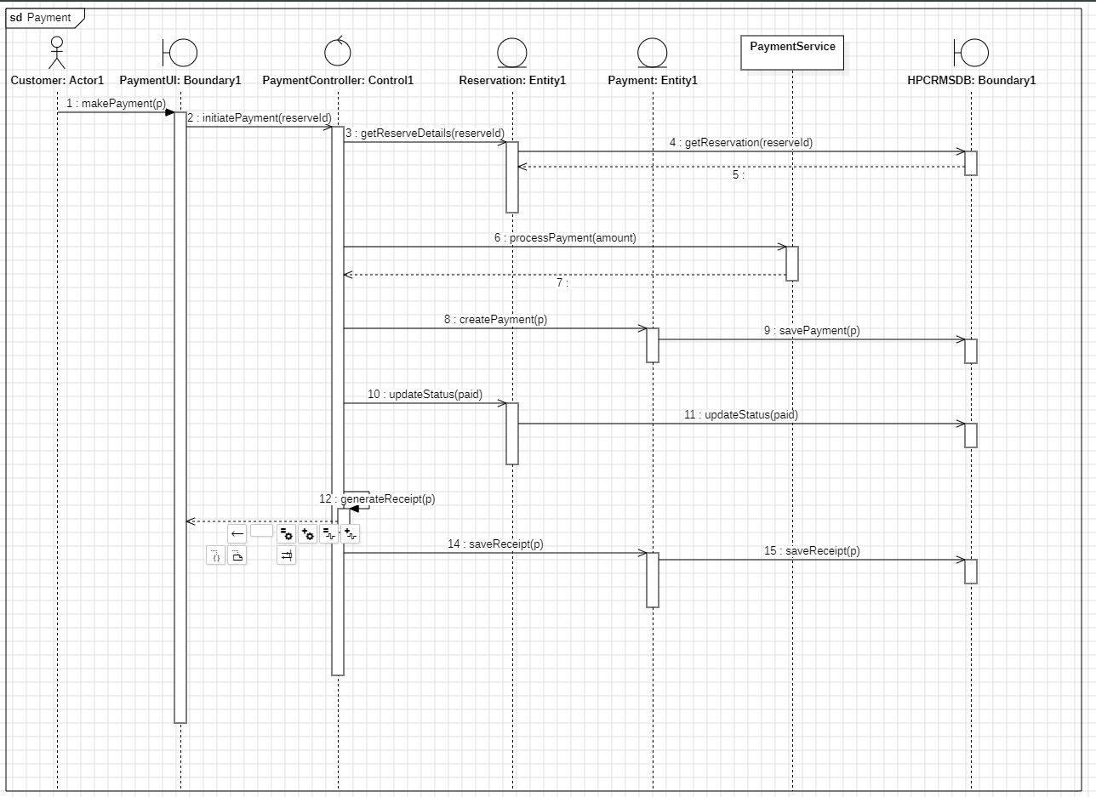
SEQUENCE DIAGRAMS
Tracing a use case: Payment
Payment processing calculates charges from the reservation, creates a payment record, and coordinates with the external Payment Service before persisting the result.
13

Slide 14
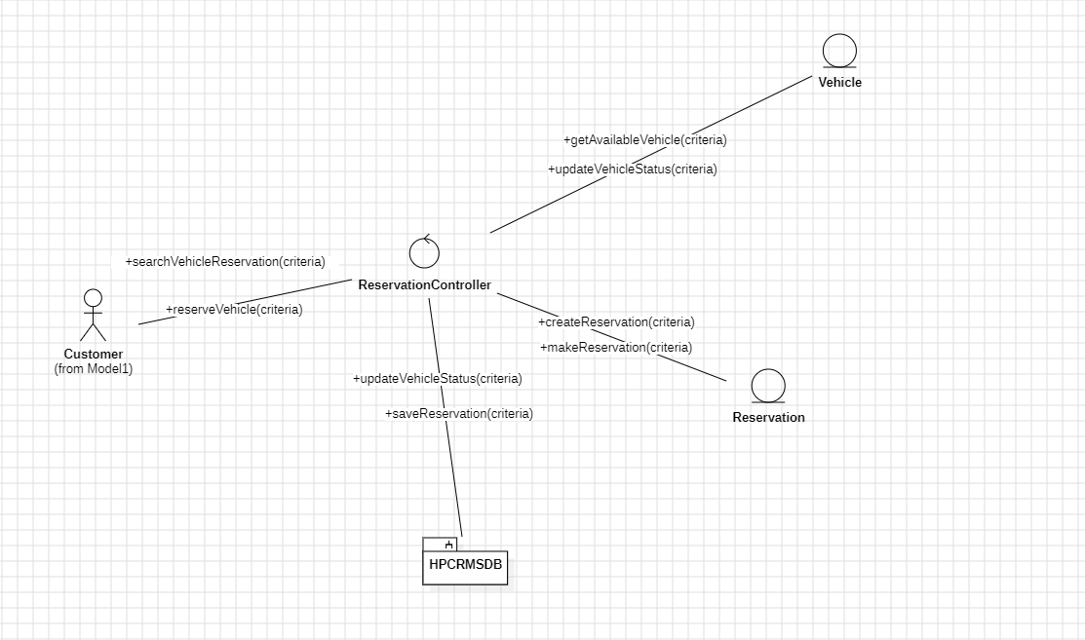
COLLABORATION DIAGRAMS
Reservation: object collaborations
The same Reservation interaction shown as a network of linked objects, with numbered messages along each link in place of a vertical time axis.
14

Slide 15
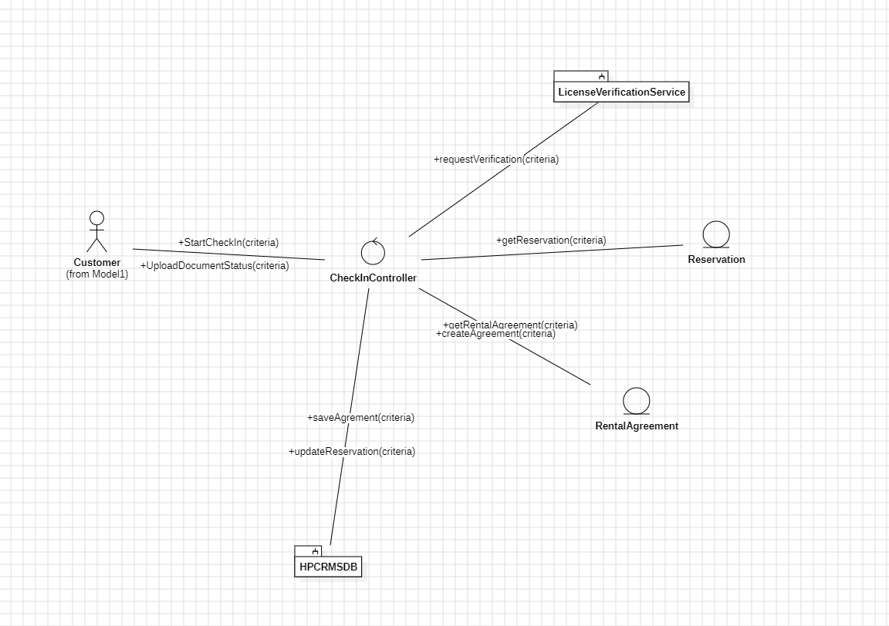
COLLABORATION DIAGRAMS
Check-In: object collaborations
CheckInController coordinates with the external License Verification Service, the Reservation and RentalAgreement objects, and the HPCRMSDB, mirroring the check-in sequence diagram.
15

Slide 16
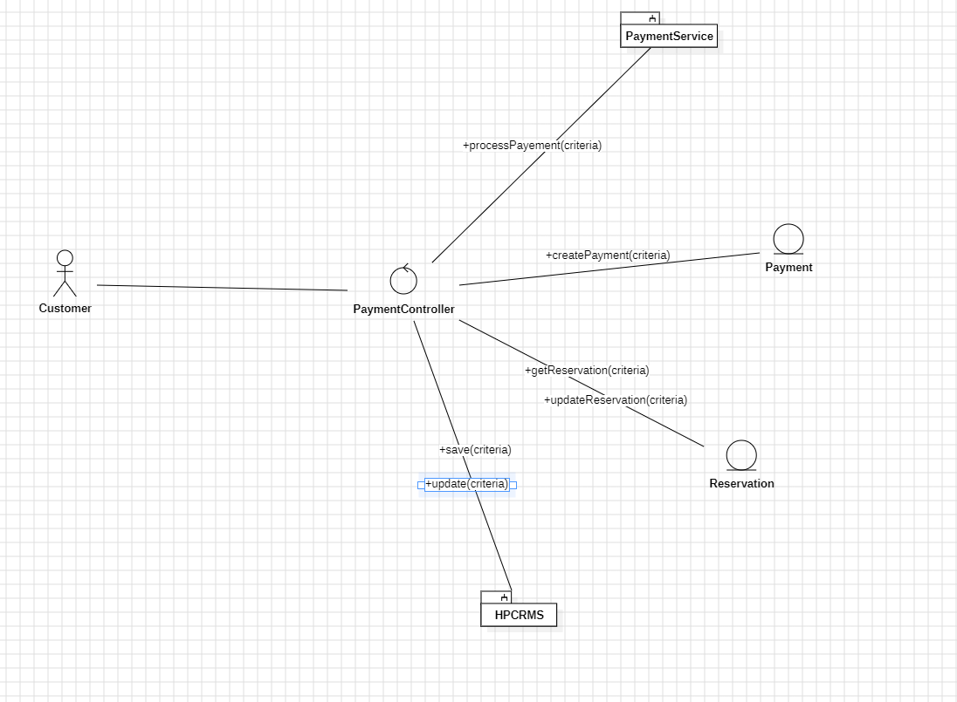
COLLABORATION DIAGRAMS
Payment: object collaborations
PaymentController links to the external Payment Service, the Payment and Reservation objects, and the HPCRMS database to complete a transaction.
16

Slide 17
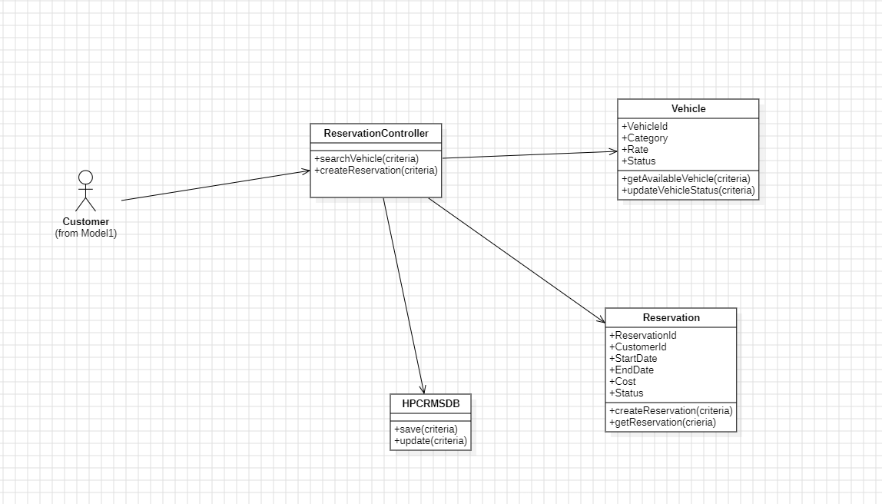
VOPC DIAGRAMS
Reservation: participating classes
The View of Participating Classes for the Reservation use case — ReservationController, Vehicle, Reservation, and HPCRMSDB — with their key attributes and operations.
17

Slide 18
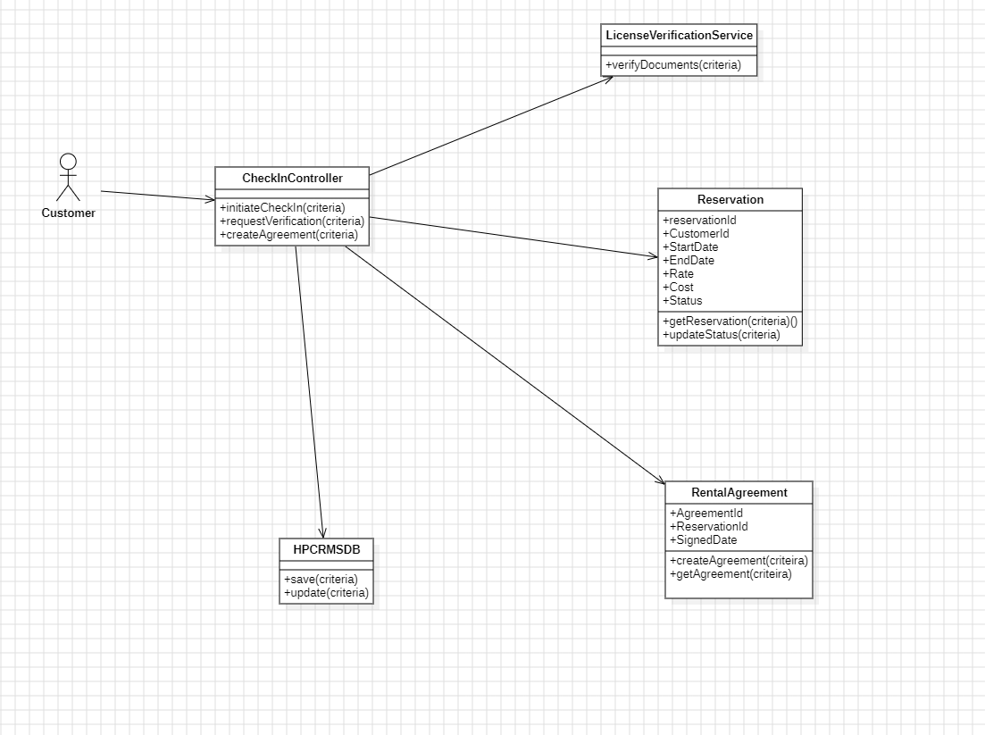
VOPC DIAGRAMS
Check-In: participating classes
The View of Participating Classes for Check-In — CheckInController, LicenseVerificationService, Reservation, RentalAgreement, and HPCRMSDB.
18

Slide 19
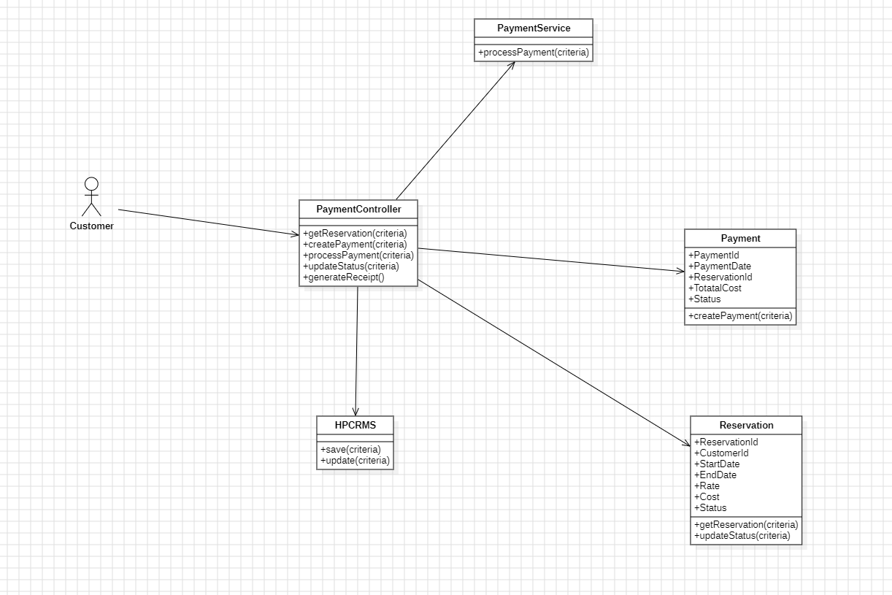
VOPC DIAGRAMS
Payment: participating classes
The View of Participating Classes for Payment — PaymentController, PaymentService, Payment, Reservation, and HPCRMS.
19

Slide 20
TESTING
Real, automated coverage — not a checkbox
1
2
3
4
40 Test Methods
Normal, Boundary & Error
Real Business Logic
Fully Isolated
JUnit 5 + Mockito across the three most critical use cases
Every test class covers all three case types, not just the happy path
Overlap detection, same-day rentals, minimum age, license expiration
Mocked repositories — no database or network, runs in seconds
20

Slide 21
SECURITY
Built to survive real scrutiny
1
2
3
4
JWT Authentication
BCrypt Password Hashing
Server-Enforced Roles
Zero Committed Secrets
Signed, expiring tokens — fully stateless session management
Passwords are never stored or logged in plaintext
Role checks run on the backend, not just hidden in the UI
Database, JWT, and admin credentials — all environment variables
21

Slide 22
LIVE DEPLOYMENT
Not a local demo — a real, deployed system
1
2
3
4
Vercel
Railway
Neon
End to End
React frontend, deployed to a global CDN
Spring Boot backend, containerized and running live
Serverless PostgreSQL, the system of record
Every request travels the real path — browser to database and back
22

Slide 23
ROADMAP
From documentation to a working system
Vision Document
System Architecture
Collaboration & VOPC
Problem statement, stakeholders, and feature needs
Layered React + Spring Boot architecture
Object collaborations and participating classes
1
2
3
4
5
6
SRS & Use-Case Model
Sequence Diagrams
Implementation & Deployment
Functional requirements, actors, use-case diagrams
Reservation, Check-In, and Payment traced in detail
Full-stack app built, tested, and live in production
Completed ● Live in Production ●
23

Slide 24
Thank You
Questions & Discussion

